Slide 1

EduCertify
Secure Certificate Verification System
Lakshya Purohit
JEFF BEZOS
Name:-
Cohort:-

Slide 2

Index
Problem Statement
Proposed Solution
Website Interface
System Flow Diagram
Working / Code
Conclusion

Slide 3
Problem Statement
Fake academic certificates are increasing.
Manual verification takes time.
Need a digital verification system.

Slide 4
Proposed Solution
EduCertify verifies certificates using a unique ID.
Displays verified student details instantly.
QR verification support.

Slide 5
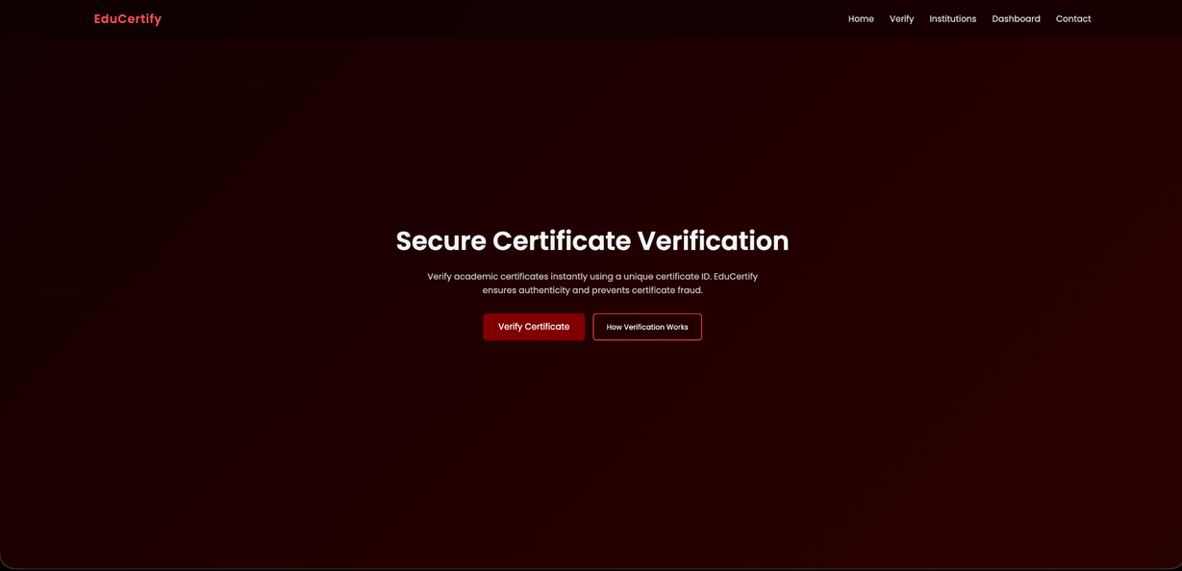
Website Interface

Slide 6
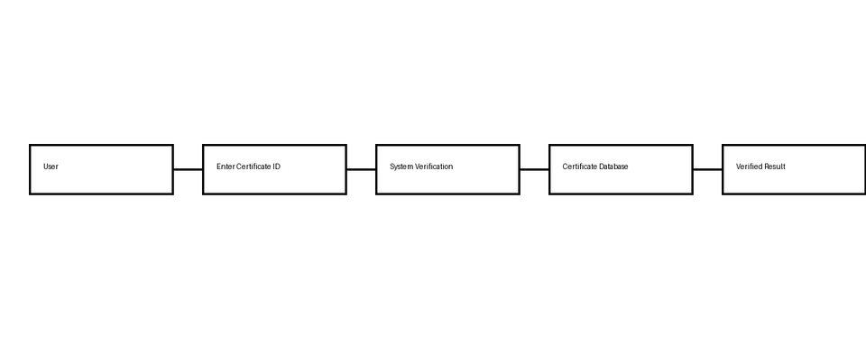
System Flow Diagram

Slide 7
Working / Code
User enters Certificate ID.
JavaScript checks certificate database.
Verified certificate is displayed.

Slide 8
Conclusion
EduCertify provides quick certificate verification.
Helps prevent certificate fraud.

Slide 9
Thank You

